Slide 1
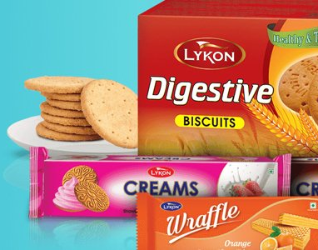
Biscuits & Wafers Market in Egypt
Consumers’ Behavior

Slide 2
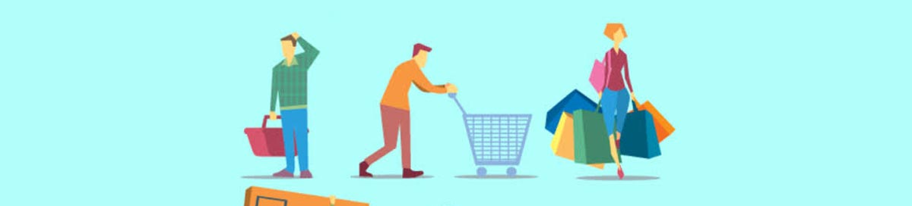
Consumers’ Behavior in consuming & purchasing biscuits & wafers in Egypt
Data is collected giving some information on places of purchase, sizes and number of packs bought at a time along with the main brands consumed regularly.

Slide 3

Data Collected:
Data were collected from 2393 consumers.
The consumers were categorized according to their gender and their region
The number of males and females were almost equal.
Most Respondents were from Delta Region, while least were from Upper Egypt.

Slide 4
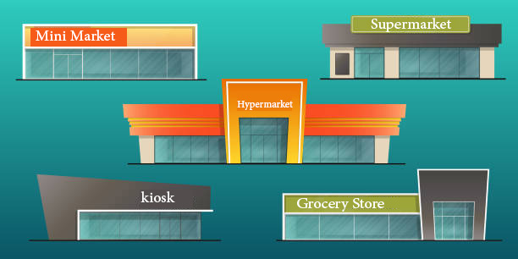
Types of Stores
Where consumers usually purchase biscuits and wafers
Options included hypermarkets, supermarkets, grocery stores, kiosks and mini markets.
Those options weren’t mutually exclusive, each respondent could choose more than one.
The most chosen was grocery stores (85% of total respondents chose it), however, this result changed when looking into regional data, as in Cairo kiosk was the most answered by 95% of surveyed Cairo consumers. There were almost no differences when classifying data by gender (no relationship between types of stores and gender).
The least chosen were hypermarkets and mini markets.

Slide 5
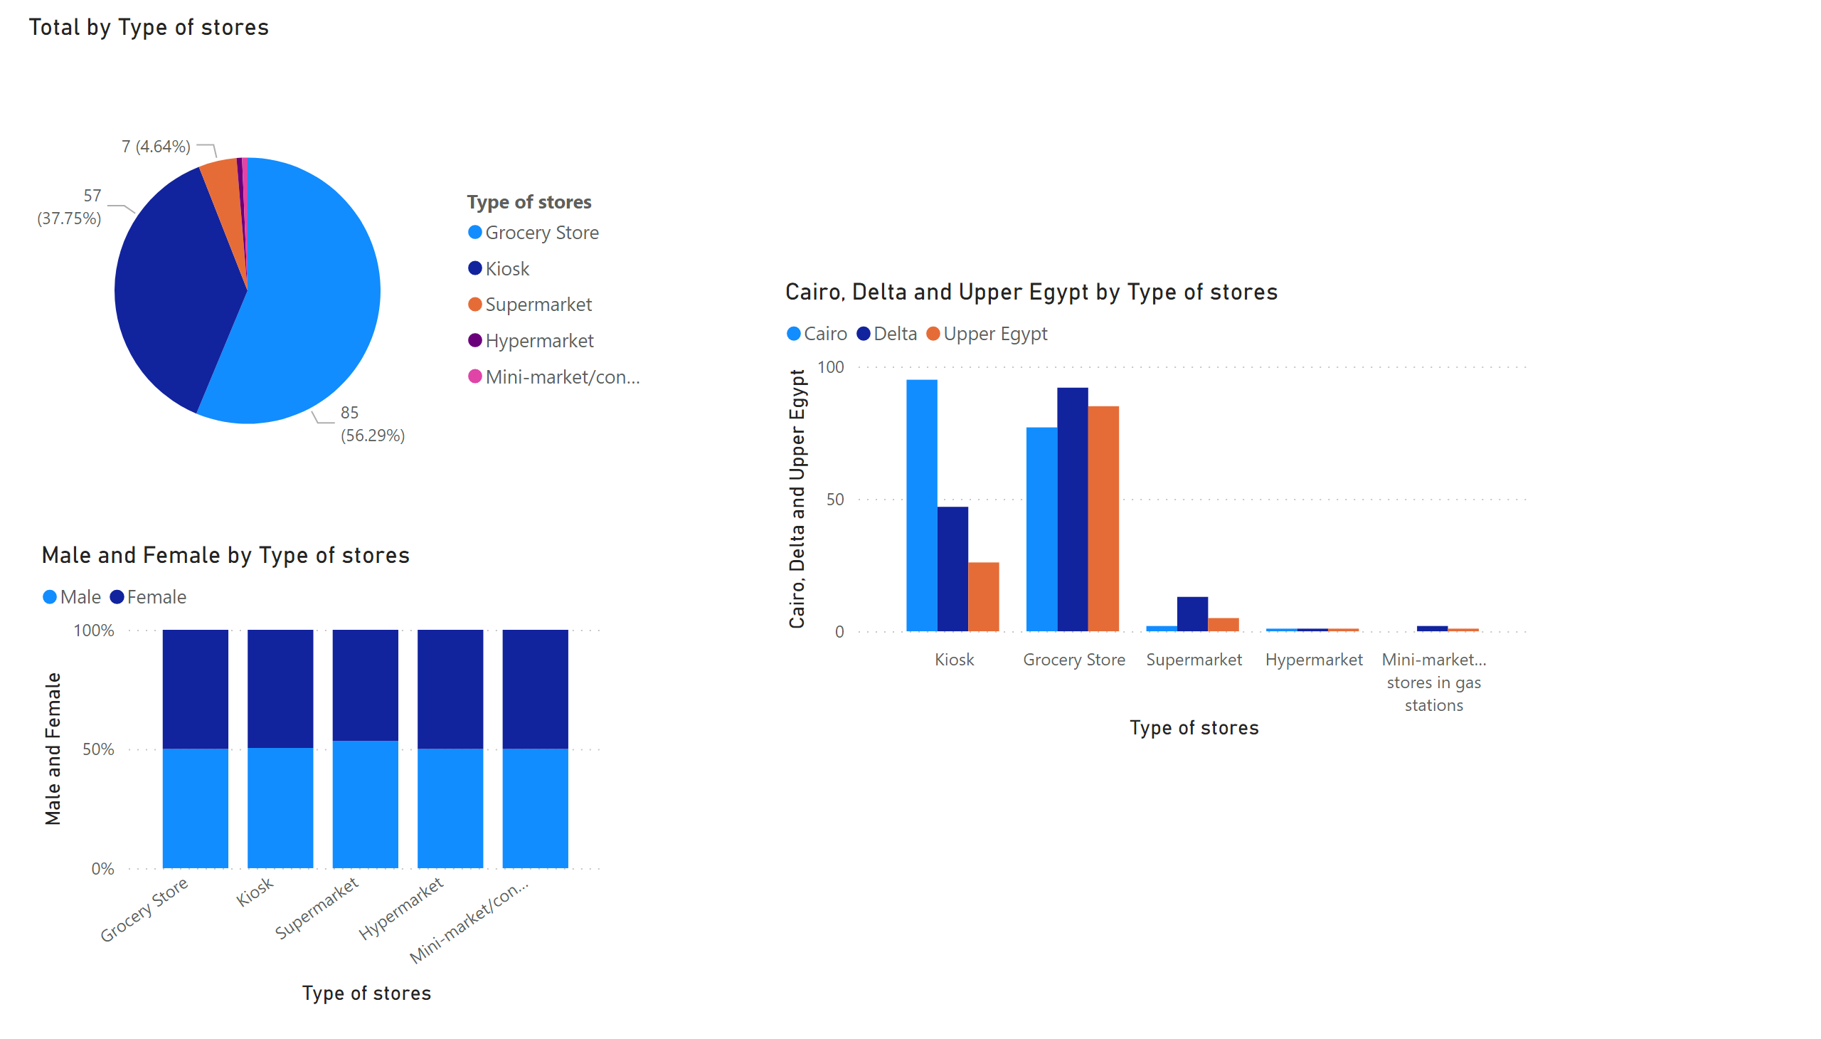
Page 9
Notes:
pieChart
No alt text provided
hundredPercentStackedColumnChart
No alt text provided
clusteredColumnChart
No alt text provided

Slide 6
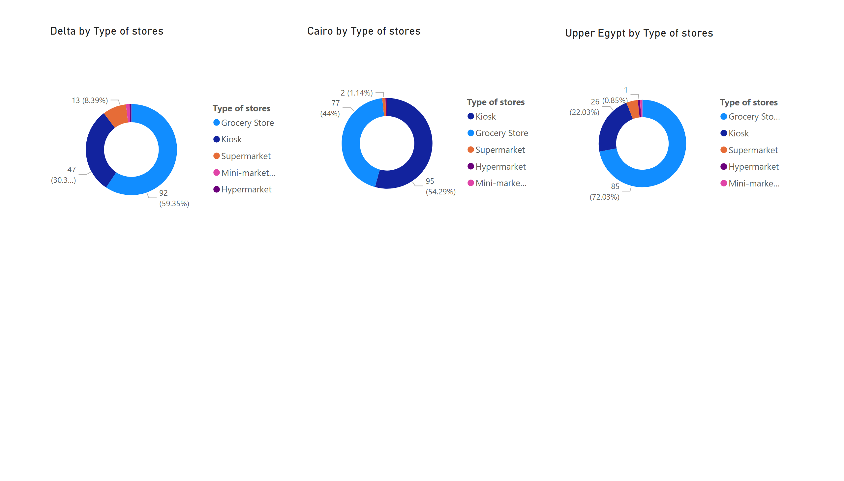
Page 10
Notes:
donutChart
No alt text provided
donutChart
No alt text provided
donutChart
No alt text provided

Slide 7
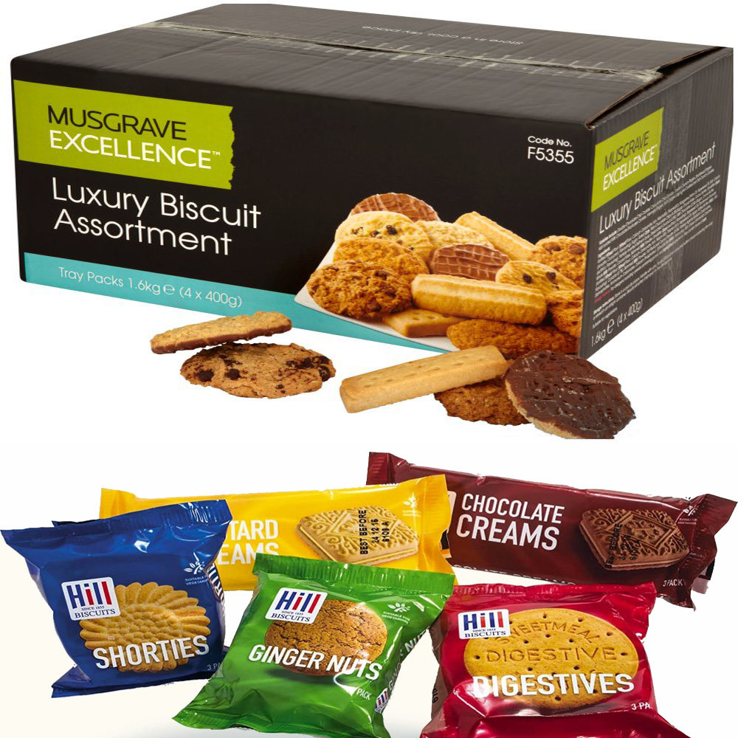
Purchase Bulks/Packs
Do consumers prefer to buy biscuits & wafers in bulks or single packs?
Only 6% of total consumers surveyed said they would buy bulks. Bulks were least purchased all over regions and gender, although the percentage differed slightly.
Packs were chosen by 94% of the total respondents.

Slide 8
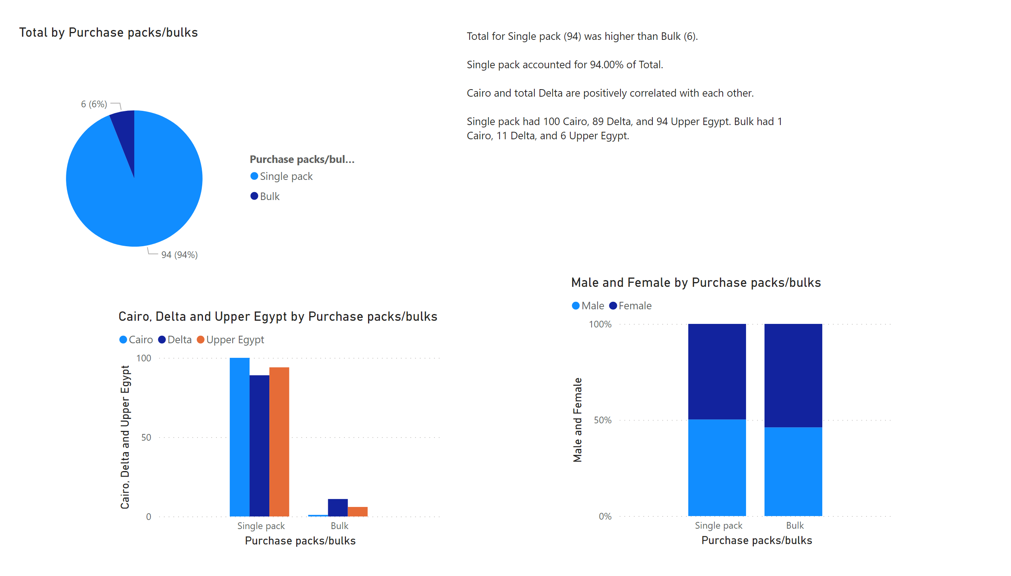
Page 8
Notes:
pieChart
No alt text provided
clusteredColumnChart
No alt text provided
hundredPercentStackedColumnChart
No alt text provided
textbox
No alt text provided

Slide 9
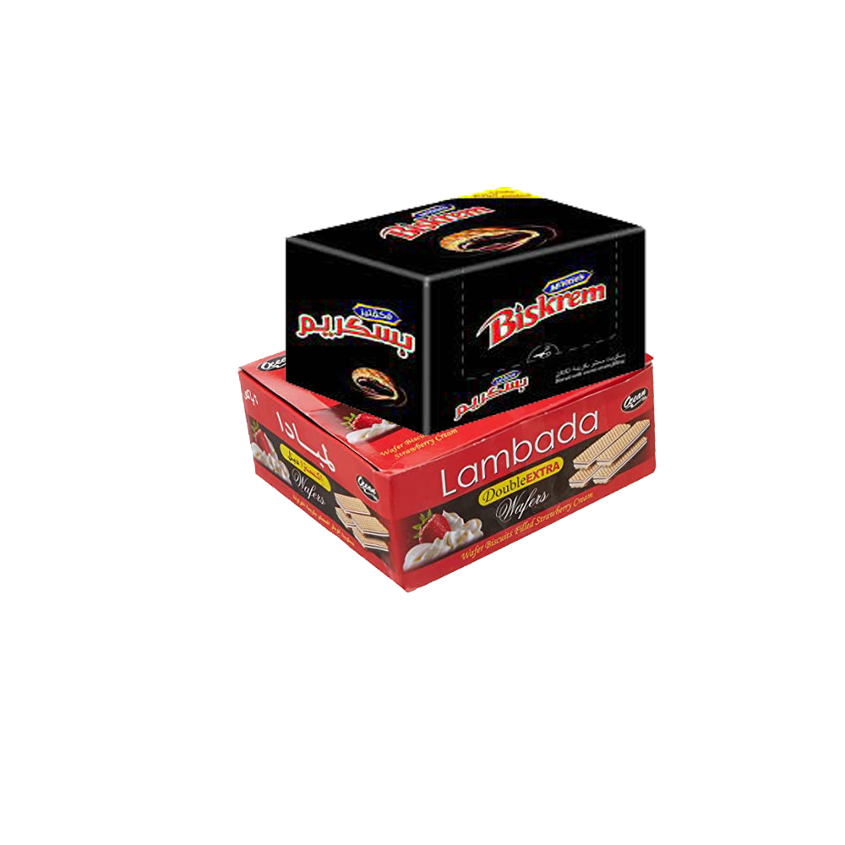
How many bulks Vs How many single packs
The amount often purchased by consumers of biscuits & wafers
If bulks, how many (choosing from 1, 2 or 3) boxes
If single packs, how many (choices from 1 to 6 & 11) packs
Bulk Boxes
Single Packs
As 6% chose bulks, they answered this question (almost 150 respondents)
60% of total consumers surveyed said they purchase 1 box, 35% answered 2 and the remaining 5% answered 3 boxes.
The responses didn’t differ by region or gender, 1 box being the most chosen and 3 boxes the least (with moderate variation in percentages).
The other 94% answered this question (about 2243 of the consumers)
2 packs were chosen the most, across all regions and genders.
In total, 6 and 11 were the least chosen by 1% of the respondents.
6 and 11 packs were the least chosen in total and across all regions and genders (ranges between 0 & 1%)

Slide 10
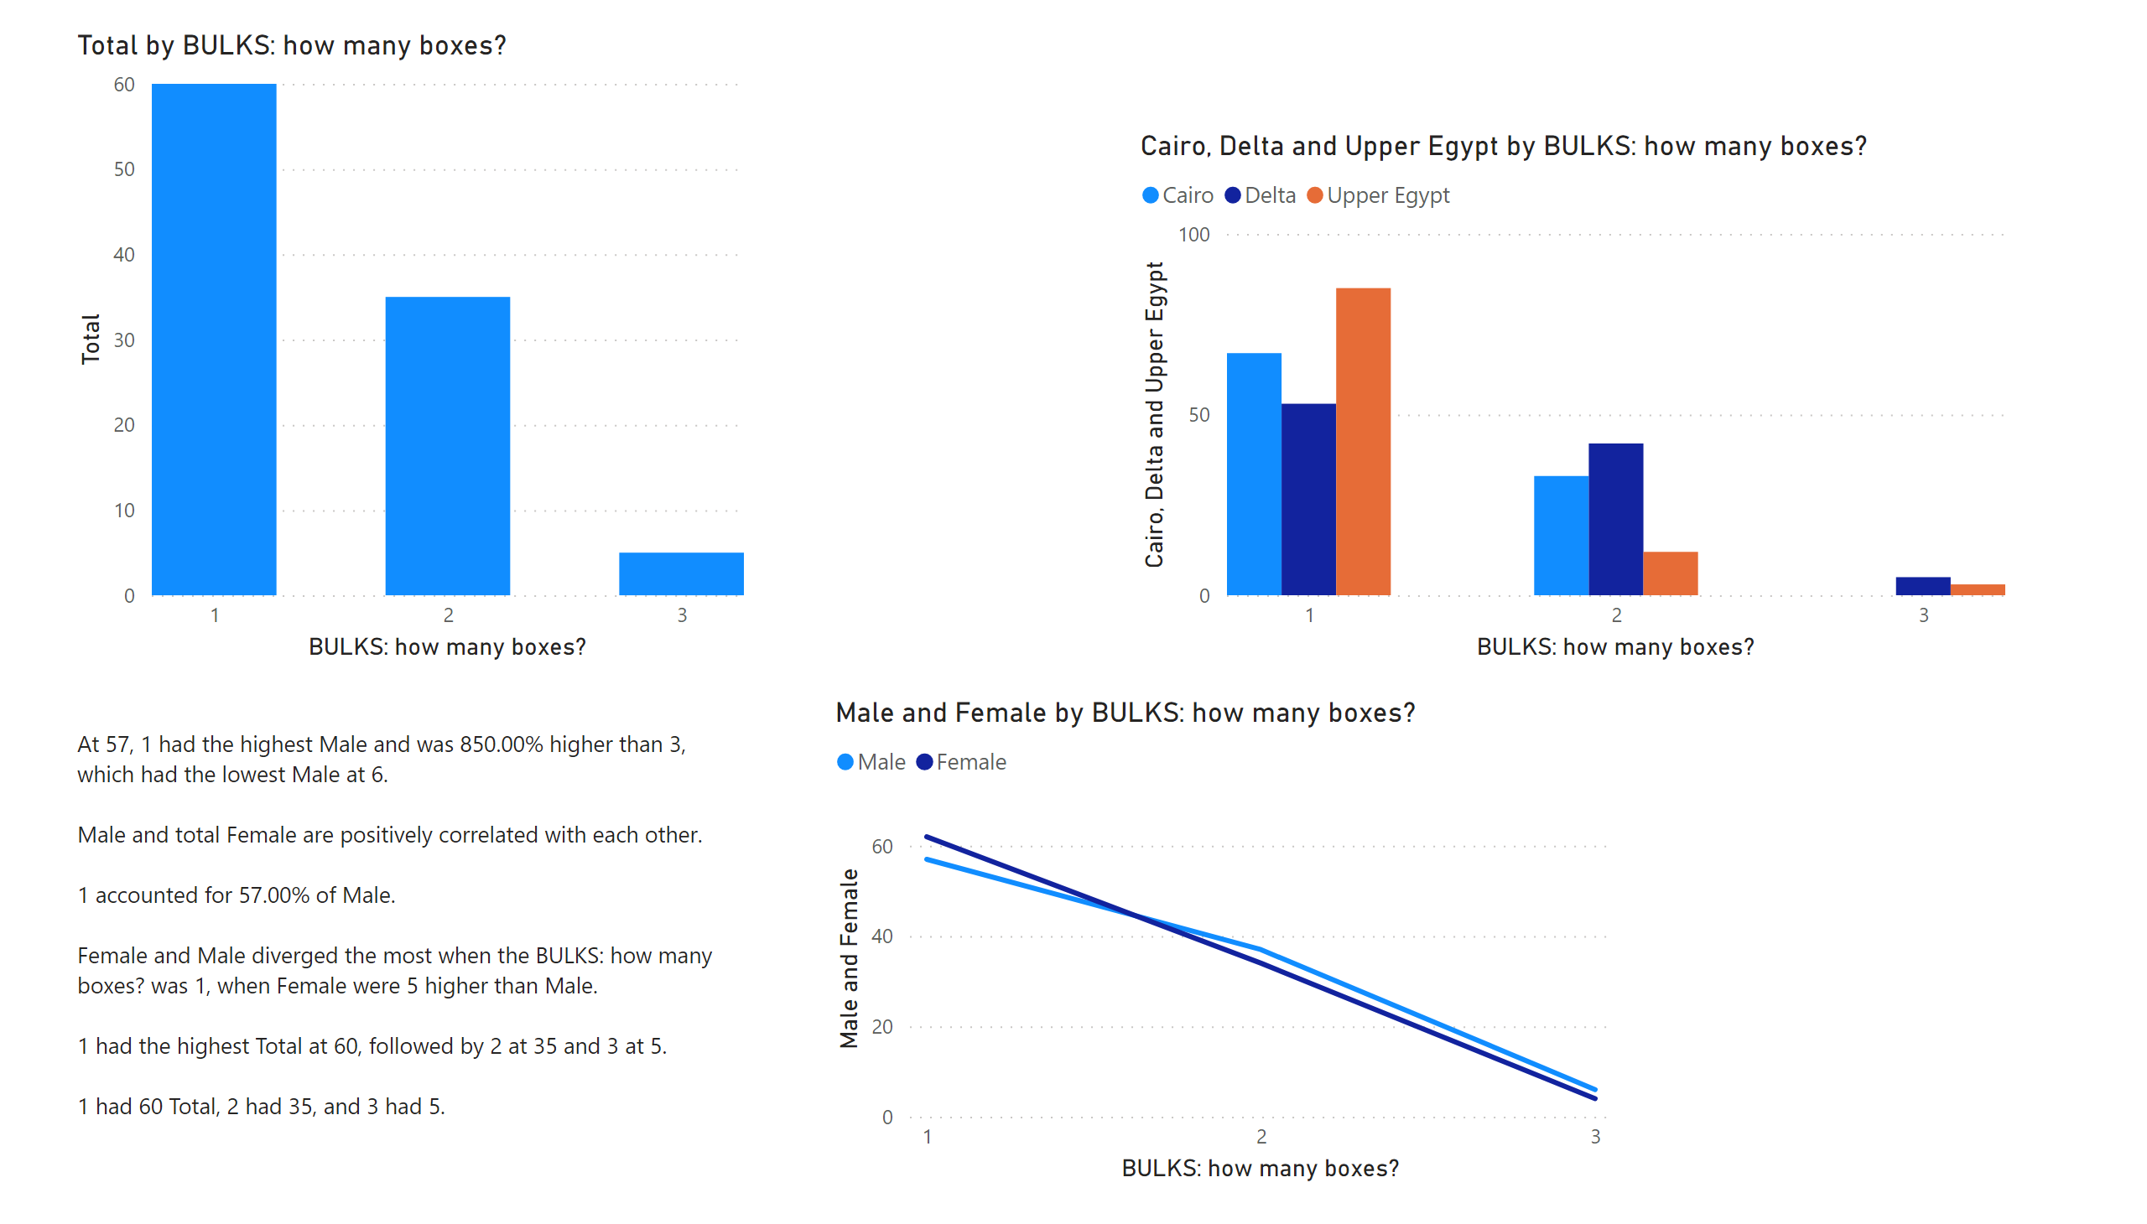
Page 7
Notes:
clusteredColumnChart
No alt text provided
clusteredColumnChart
No alt text provided
lineChart
No alt text provided
textbox
No alt text provided

Slide 11
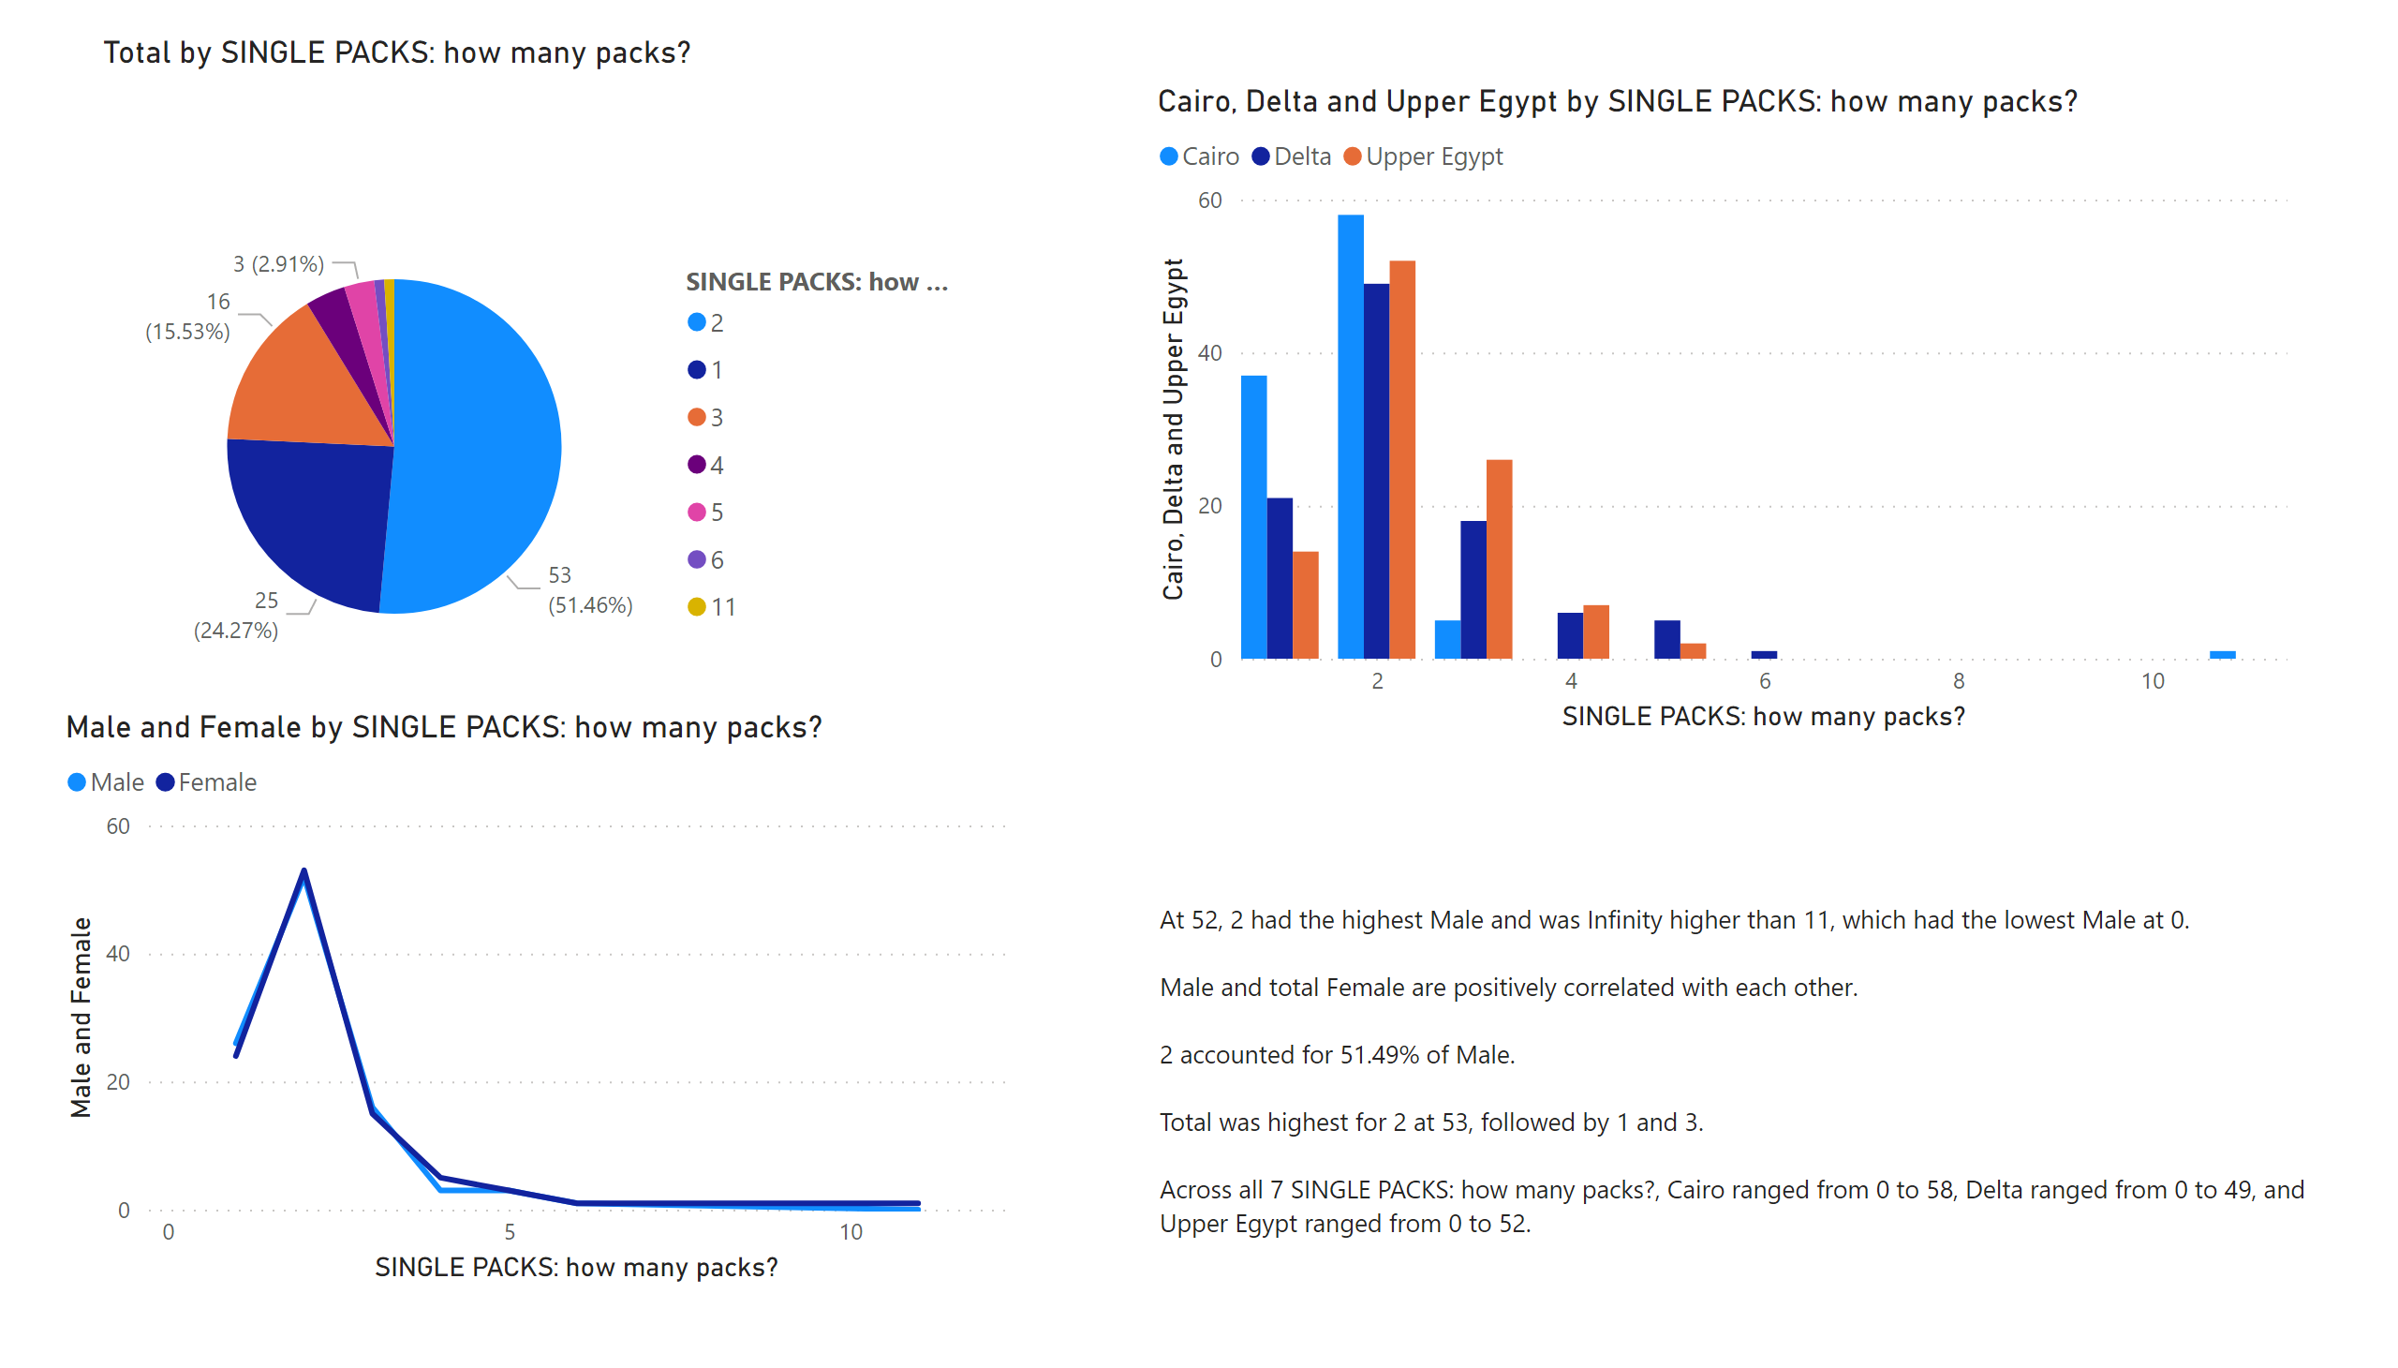
Page 6
Notes:
pieChart
No alt text provided
clusteredColumnChart
No alt text provided
lineChart
No alt text provided
textbox
No alt text provided

Slide 12
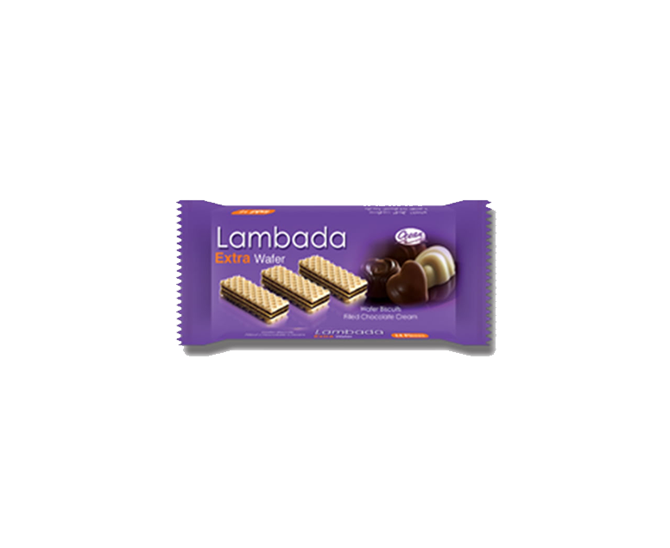
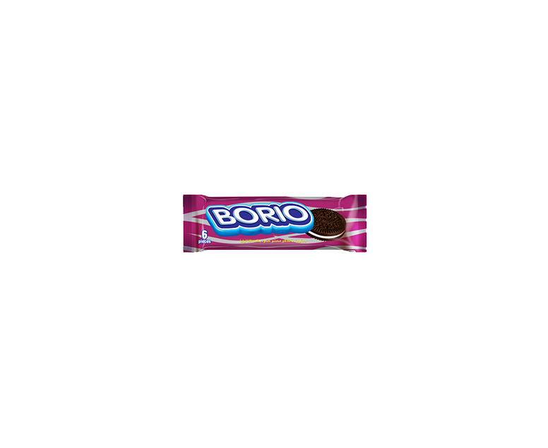
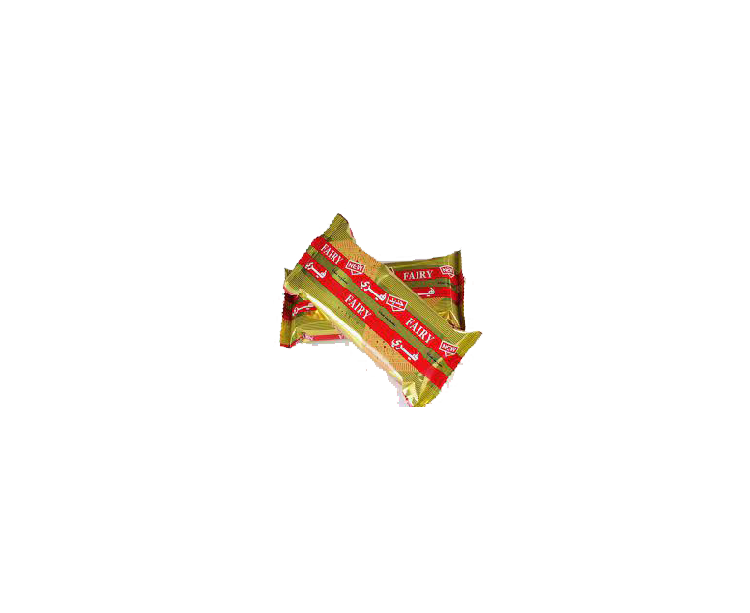
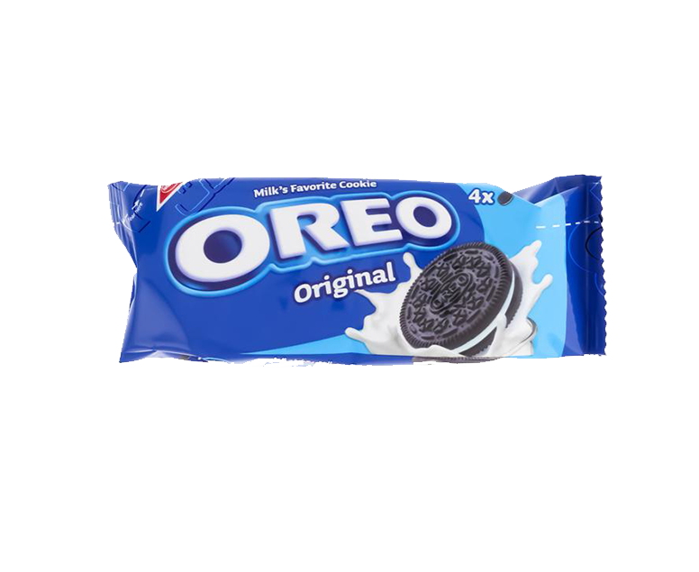
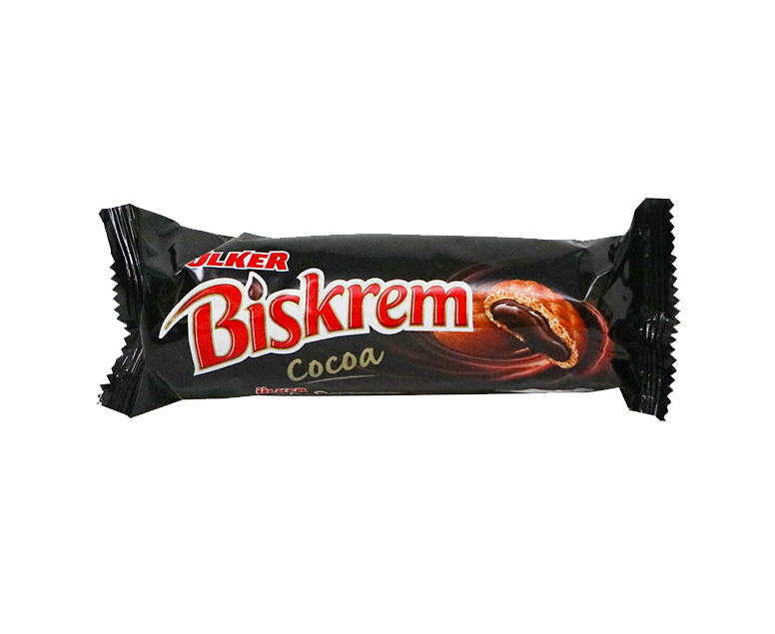
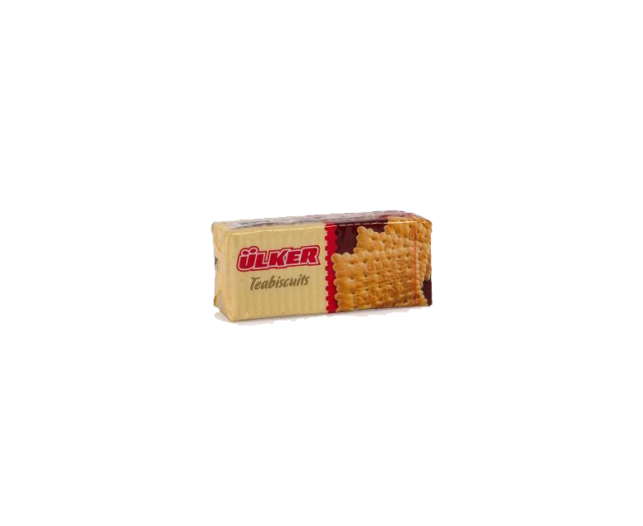
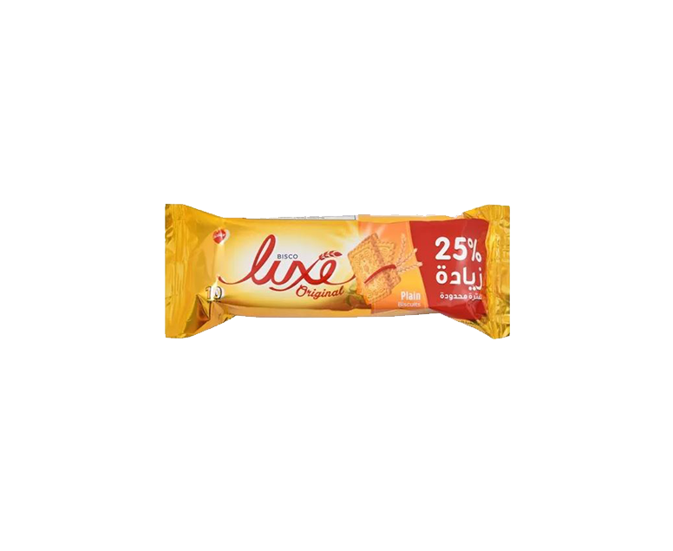
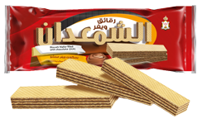
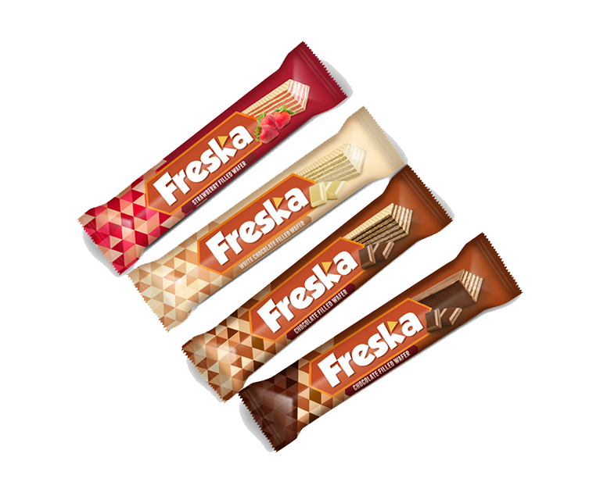
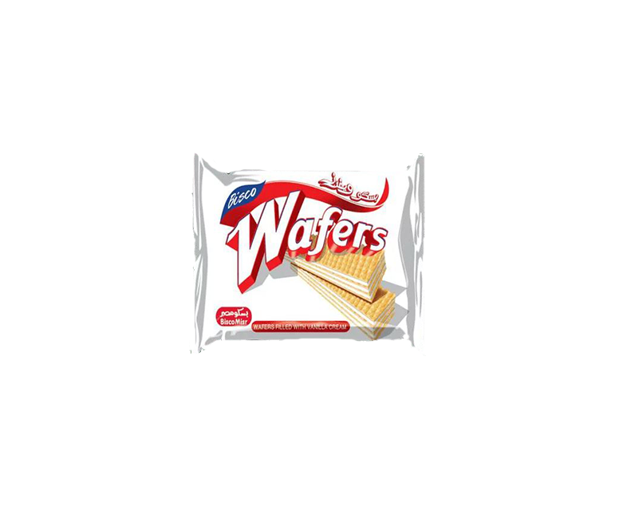
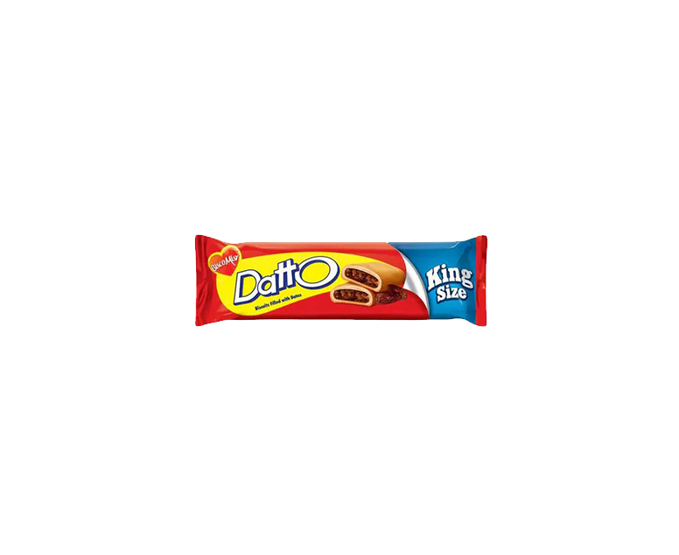
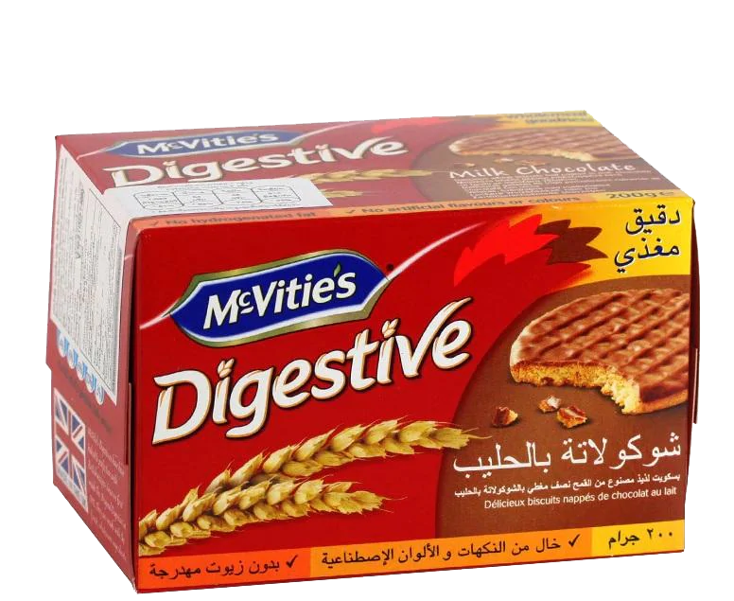
Brands Most Purchased
Which brands in the Egyptian biscuits & Wafers market are most purchased by consumers?

Slide 13
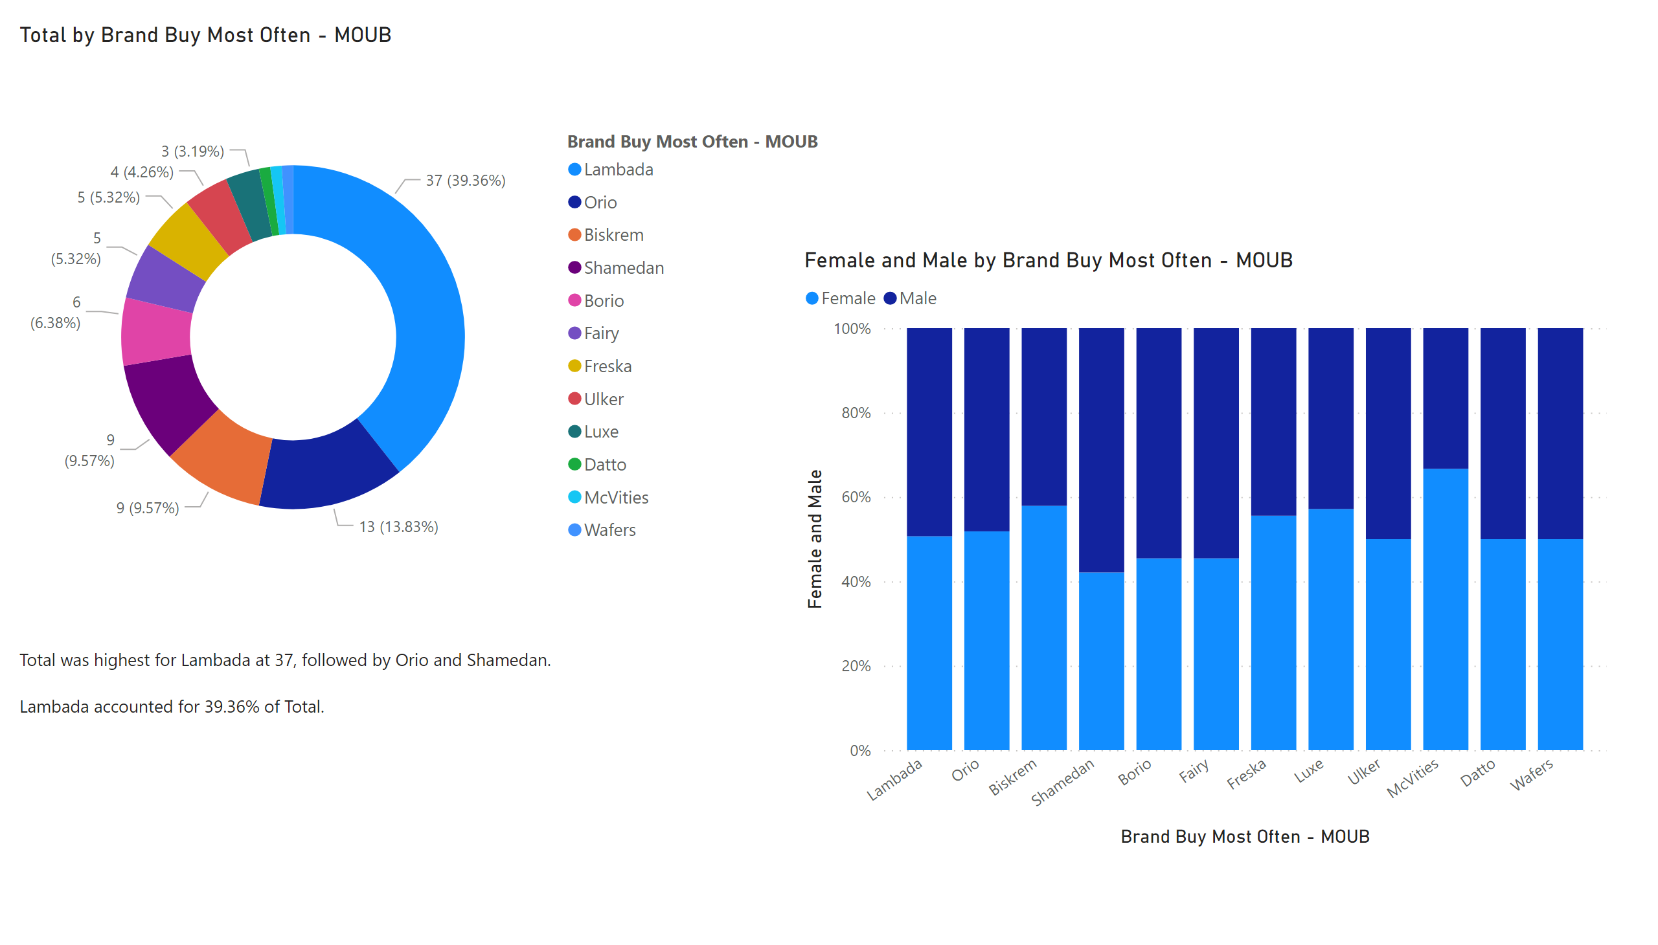
Page 4
Notes:
donutChart
No alt text provided
textbox
No alt text provided
hundredPercentStackedColumnChart
No alt text provided

Slide 14
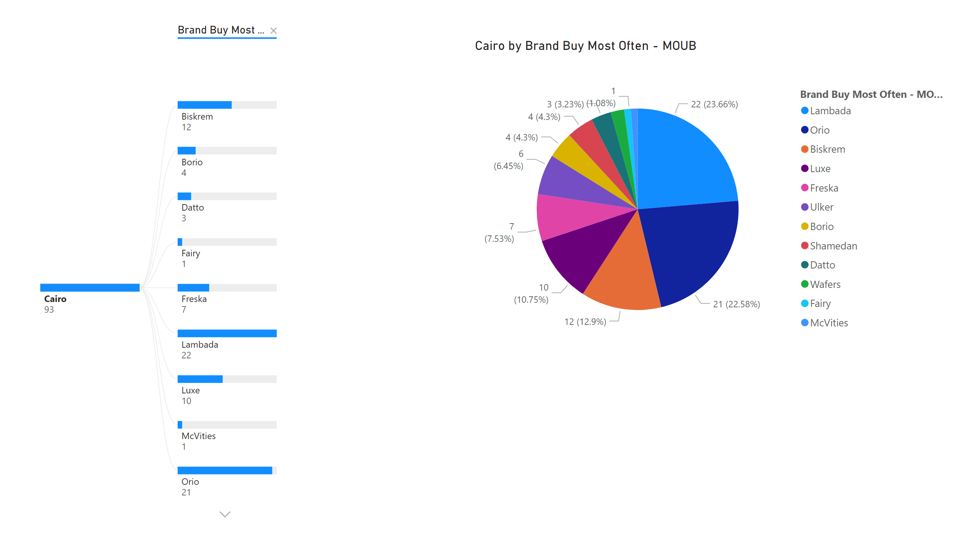
Page 1
Notes:
decompositionTreeVisual
No alt text provided
pieChart
No alt text provided

Slide 15
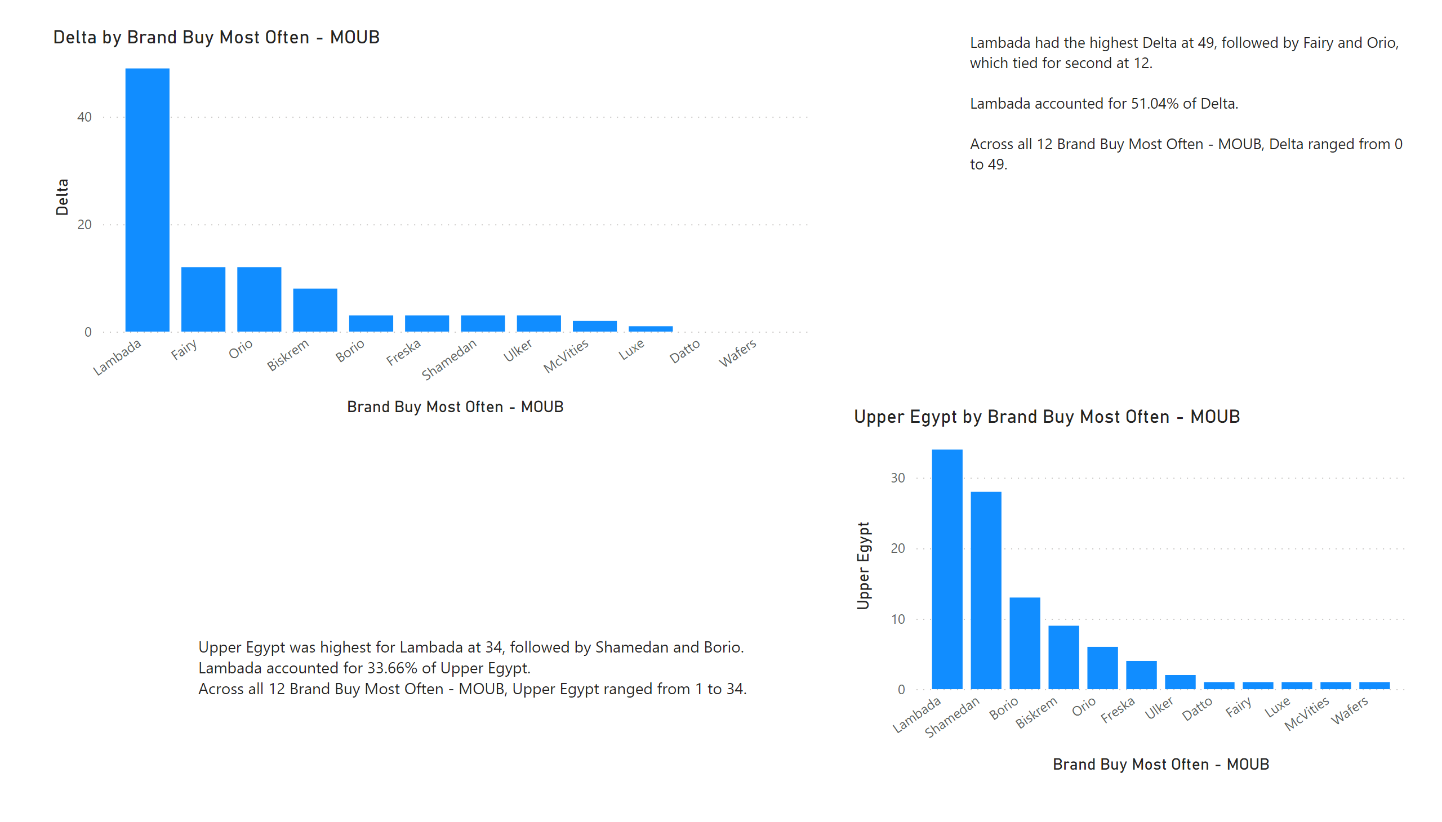
Page 2
Notes:
columnChart
No alt text provided
textbox
No alt text provided
columnChart
No alt text provided
textbox
No alt text provided

Slide 16
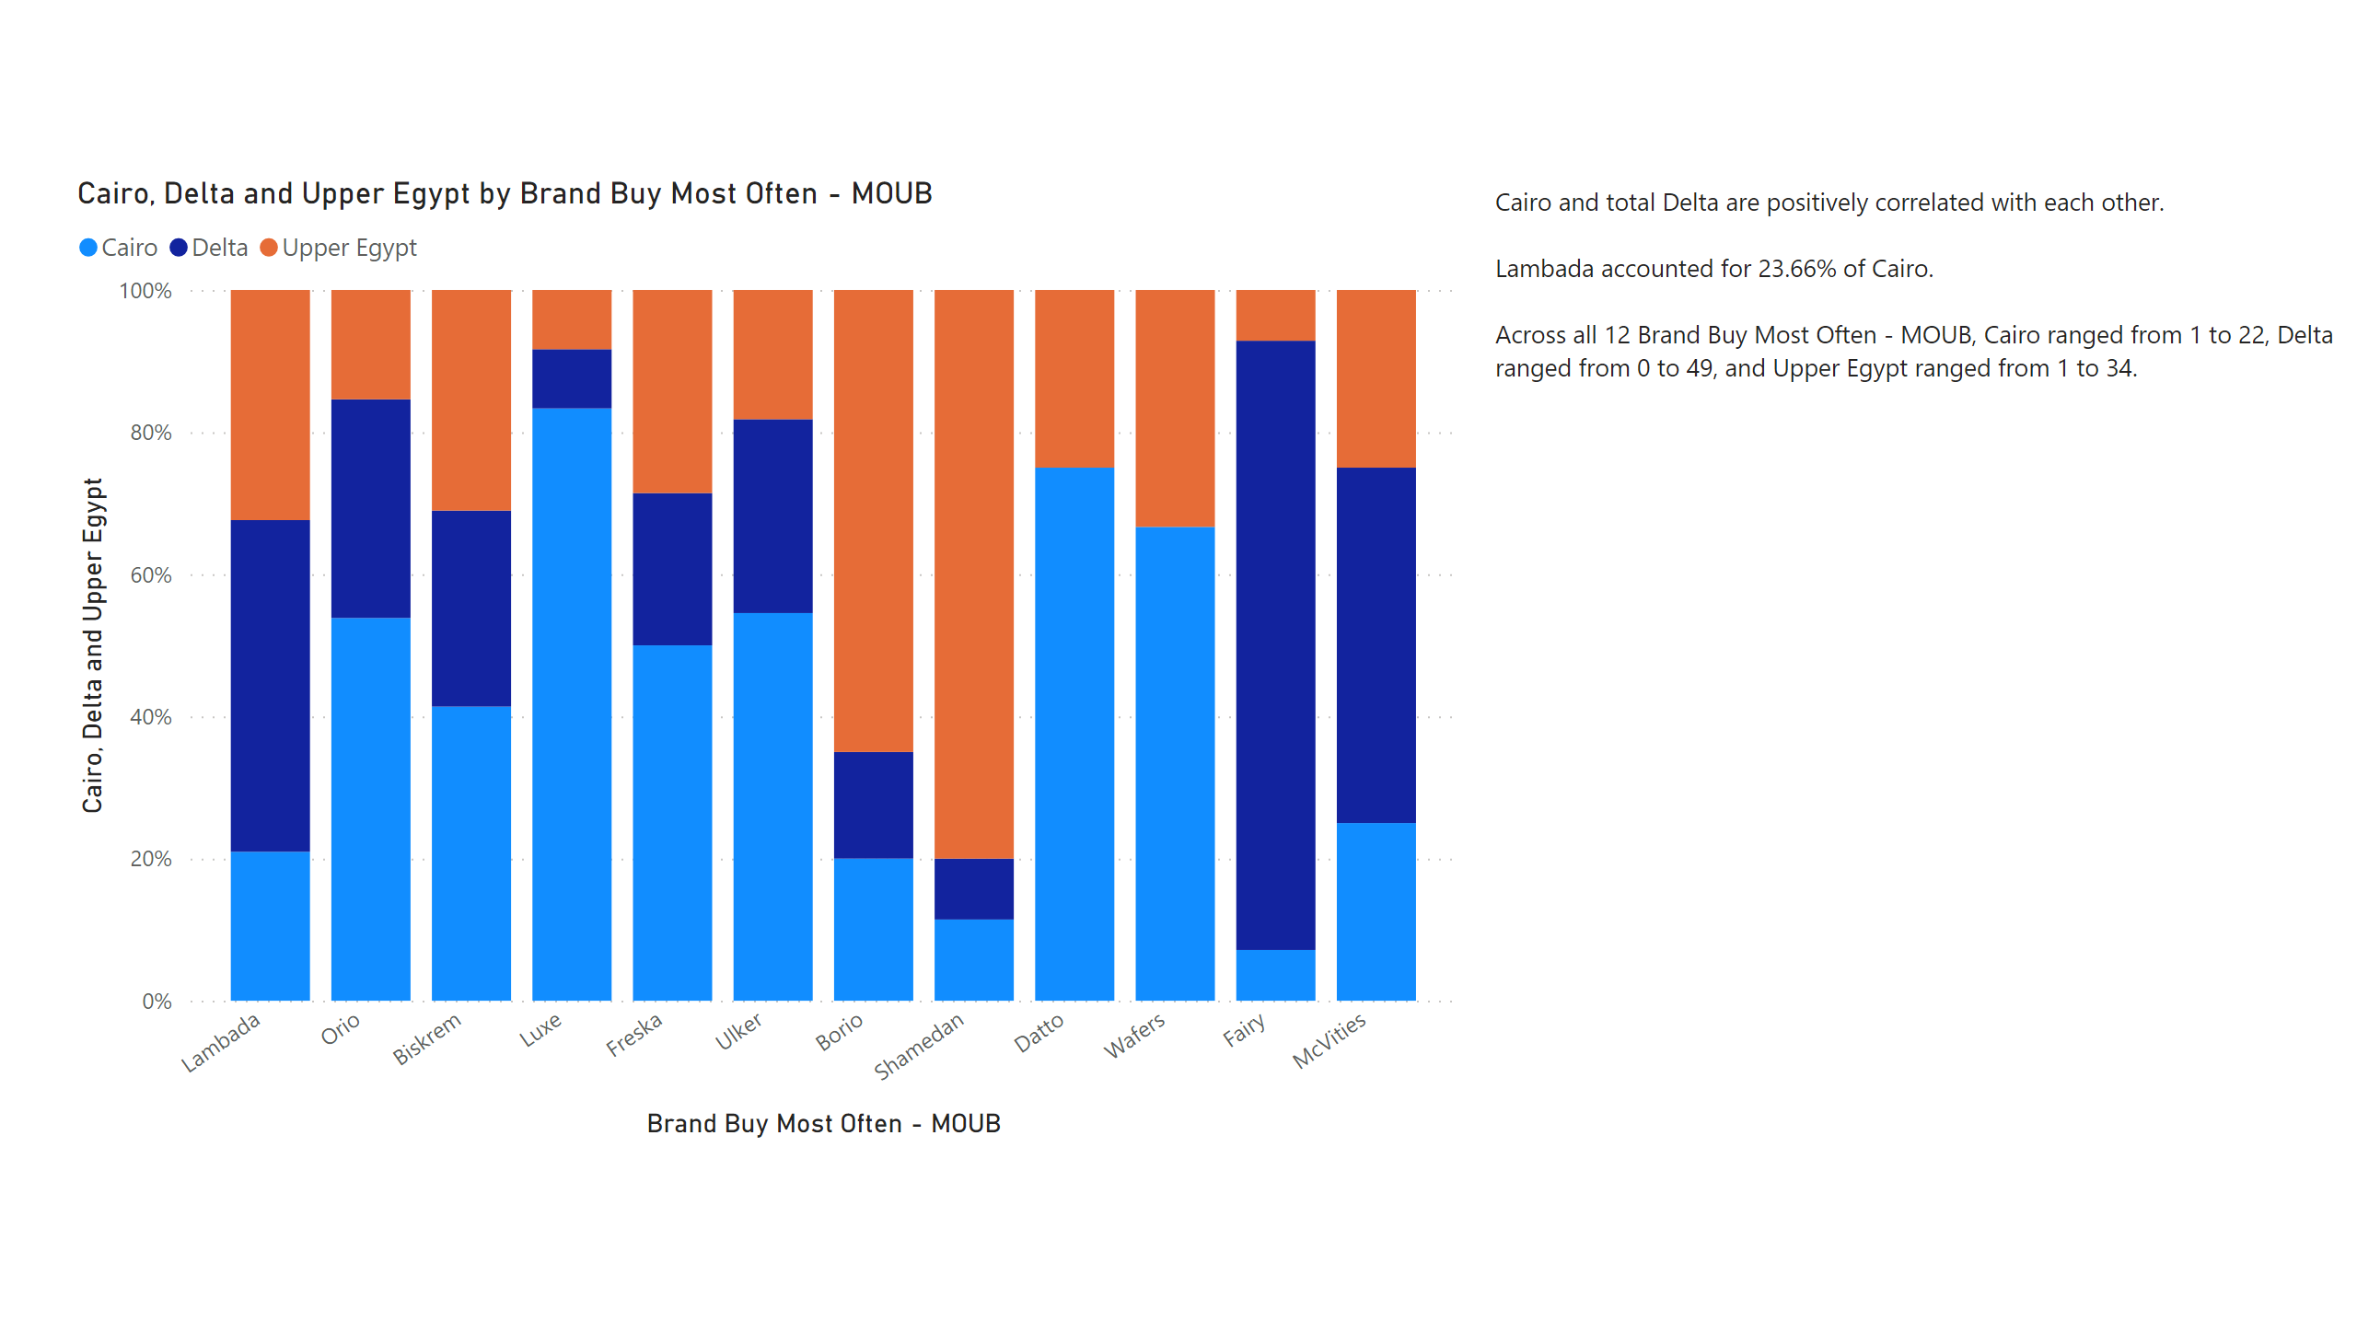
Page 5
Notes:
hundredPercentStackedColumnChart
No alt text provided
textbox
No alt text provided

Slide 17
Business Recommendations for Biscuit Market Players
Regarding types of stores:
Focus more on being available in grocery stores
Make more offers in hypermarkets to encourage people to buy from there.
Make your products available in kiosk in Cairo.
Regarding Bulks or Packs:
Make offers on single packs to encourage people on buying more.
Invest on more research to explain what influences the purchase decision.
Regional marketing campaigns maybe needed to encourage consumption in certain areas.

Slide 18
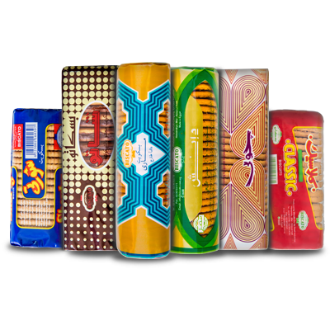
THANK YOU!
Afnan Alaa
View in Power BI
Phone:
01140506780
Email:
afnanalaa88@gmail.com

